Slide 1
EECT 122 LAB NOTEBOOK
Cody Fletcher

Slide 2
Table of Contents
Lab 0
  Pg. 132 Fig. 4-2 pg. 2
Lab 1
  AND/OR Operation
Lab 2
  Nand Latch
Lab 3
  SR Latch
Lab 4
  D Latch
Lab 5
  JK Latch
Lab 6
  2”s compliment
Lab 7
  74lLS283
Lab 8
  Asynchronous Counter
Lab 9
  Synchronous Counter
Lab 10
  MOD 12
Lab 11
  CMOS Characterization
Lab 12
  74LS138
Lab 13
  555 Timer 74LS90 74LS47 Hex display
Design 1
  Make 3 clocks from 1
Lab FF
  Lou’s Design

Slide 3
Lab 0
Pg. 132 Fig. 4-2
By: Cody Fletcher, Ramon Jamili
Bench 1
Instructor: Andy Bell
Class: EECT122

Slide 4
Objectives, Equipment, and Parts:
Recreate the example circuit from pg. 132 fig 4-2 in Muiltisim
Muiltisim
Excel

Slide 5
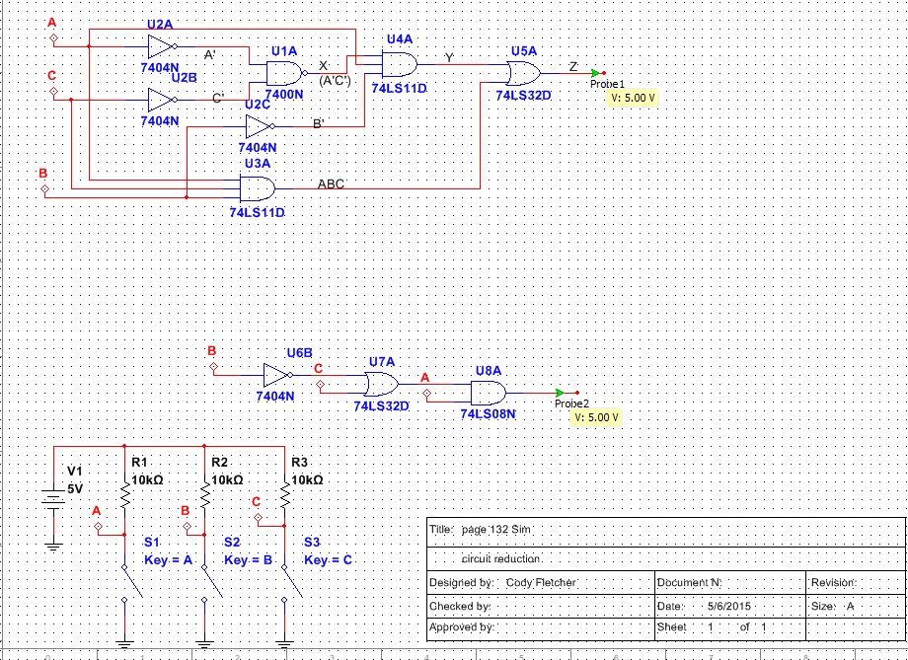
Data/Lab Results/Simulations/Schematics:
 | A | B | C |  | A' | C' | X(A'C') |  | Y(B') |  | Z(ABC) |  | XY |  | XYZ
 | 0 | 0 | 0 |  | 1 | 1 | 0 |  | 1 |  | 0 |  | 0 |  | 0
 | 0 | 0 | 1 |  | 1 | 0 | 1 |  | 1 |  | 0 |  | 0 |  | 0
 | 0 | 1 | 0 |  | 1 | 1 | 0 |  | 0 |  | 0 |  | 0 |  | 0
 | 0 | 1 | 1 |  | 1 | 0 | 1 |  | 0 |  | 0 |  | 0 |  | 0
 | 1 | 0 | 0 |  | 0 | 1 | 1 |  | 1 |  | 0 |  | 1 |  | 1
 | 1 | 0 | 1 |  | 0 | 0 | 1 |  | 1 |  | 0 |  | 1 |  | 1
 | 1 | 1 | 0 |  | 0 | 1 | 1 |  | 0 |  | 0 |  | 0 |  | 0
 | 1 | 1 | 1 |  | 0 | 0 | 1 |  | 0 |  | 1 |  | 0 |  | 1
 |  |  |  |  | A | B | C |  | B' |  | B'+C |  | Z
 |  |  |  |  | 0 | 0 | 0 |  | 1 |  | 1 |  | 0
 |  |  |  |  | 0 | 0 | 1 |  | 1 |  | 1 |  | 0
 |  |  |  |  | 0 | 1 | 0 |  | 0 |  | 0 |  | 0
 |  |  |  |  | 0 | 1 | 1 |  | 0 |  | 1 |  | 0
 |  |  |  |  | 1 | 0 | 0 |  | 1 |  | 1 |  | 1
 |  |  |  |  | 1 | 0 | 1 |  | 1 |  | 1 |  | 1
 |  |  |  |  | 1 | 1 | 0 |  | 0 |  | 0 |  | 0
 |  |  |  |  | 1 | 1 | 1 |  | 0 |  | 1 |  | 1

Slide 6
Troubleshooting and Conclusion:
Recreated the circuit and it functioned properly

Slide 7
Lab 1
AND/OR Operation
By: Cody Fletcher, Dakota Johnson, Josiah Abel
Bench 6
Instructor: Andy Bell
Class: EECT122
Date: 1/28/15

Slide 8
Objectives, Equipment, and Parts:
To test AND/OR Operations
This lab is based on Boolean theories 1-12
Elvis 2 S# 1677D1E
Miscellaneous wires
74LS08 and 74LS32 chips
74LS08 and 74LS32 Data sheets
1K resistors
Dip switch

Slide 9
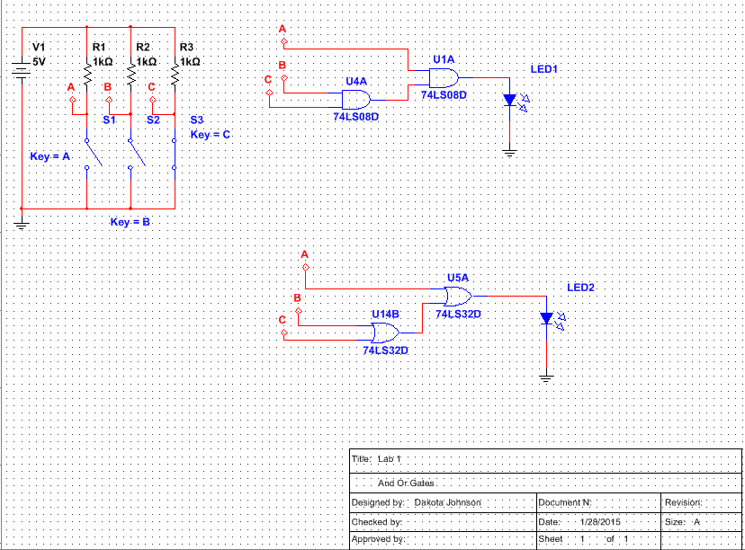
Data/Lab Results/Simulations/Schematics:
AND |  |  |  |  | OR
 | A | B | C | X |  | A | B | C | X
 | 0 | 0 | 0 | 0 |  | 0 | 0 | 0 | 0
 | 0 | 0 | 1 | 0 |  | 0 | 0 | 1 | 1
 | 0 | 1 | 0 | 0 |  | 0 | 1 | 0 | 1
 | 0 | 1 | 1 | 0 |  | 0 | 1 | 1 | 1
 | 1 | 0 | 0 | 0 |  | 1 | 0 | 0 | 1
 | 1 | 0 | 1 | 0 |  | 1 | 0 | 1 | 1
 | 1 | 1 | 0 | 0 |  | 1 | 1 | 0 | 1
 | 1 | 1 | 1 | 1 |  | 1 | 1 | 1 | 1

Slide 10
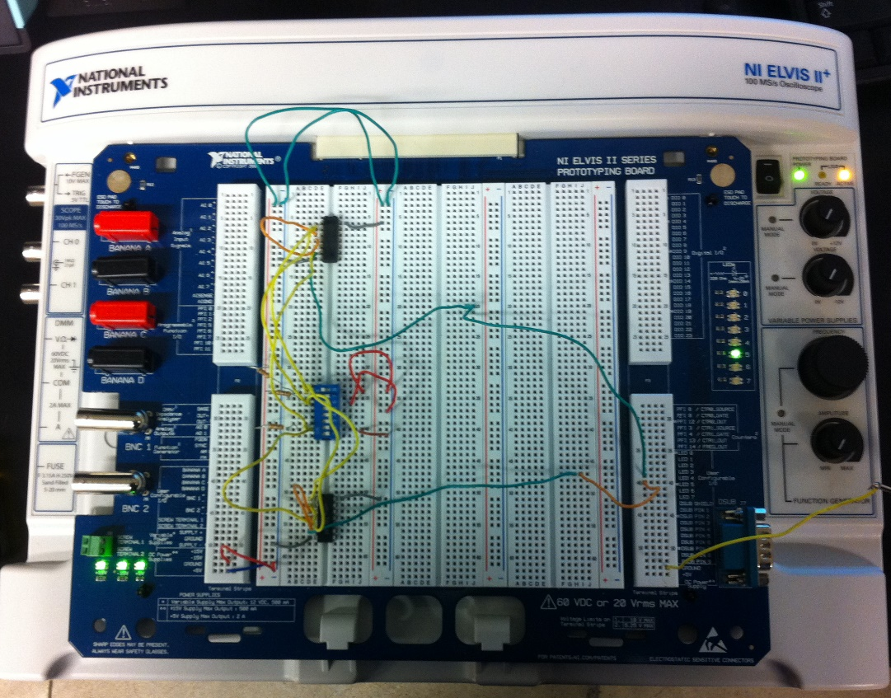
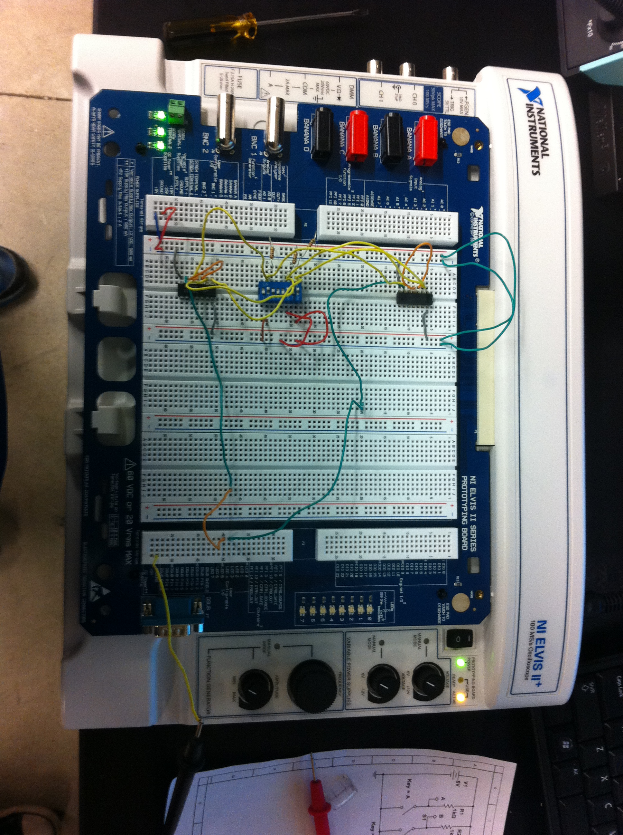
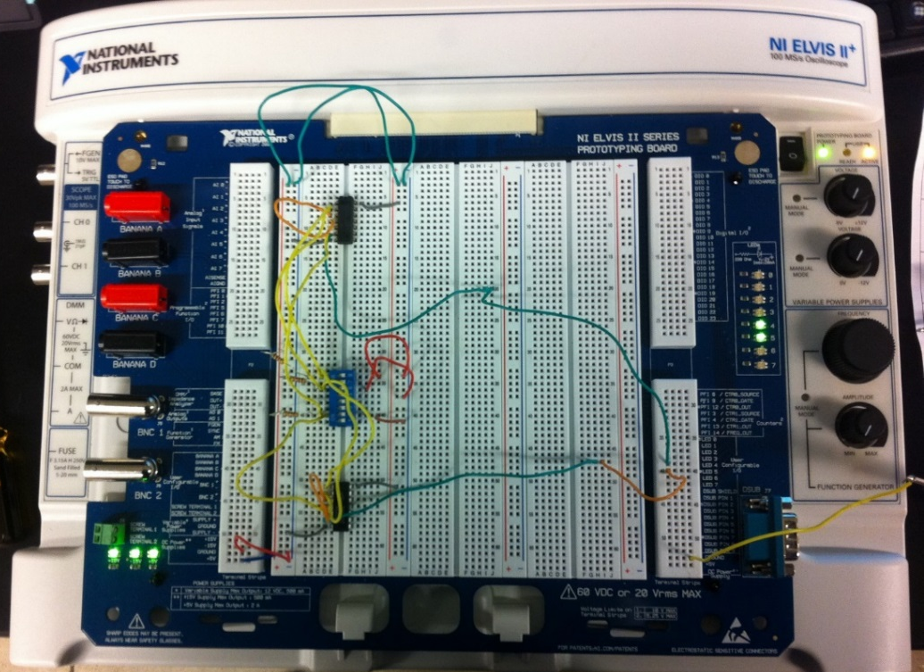
Data/Lab Results/Simulations/Schematics:

Slide 11
Troubleshooting and Conclusion:
The circuits that were built in the lab correlated to the Multisim simulations and truth tables

Slide 12
Lab 2
Nand Latch
By: Cody Fletcher, Ramon Jamili
Bench 1
Instructor: Andy Bell
Class: EECT122

Slide 13
Objectives, Equipment, and Parts:
Test ch. 5 Flip Flop
Test the states of the latch
Elvis 2 S# 1677D1E
Muiltisim
Miscellaneous wires
74LS00 chips
74LS00 Data sheet
1K resistors
Dip switch

Slide 14
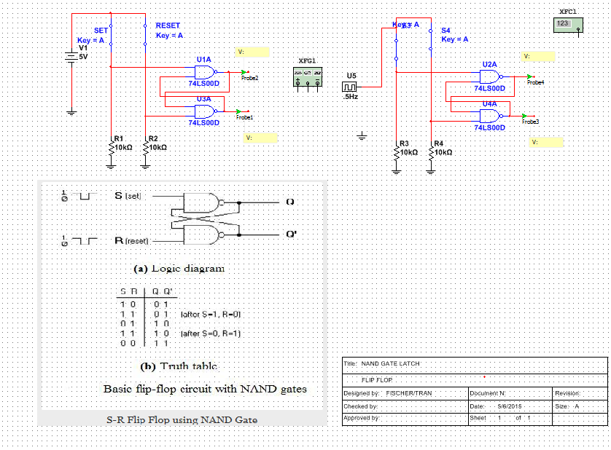
Data/Lab Results/Simulations/Schematics:

Slide 15
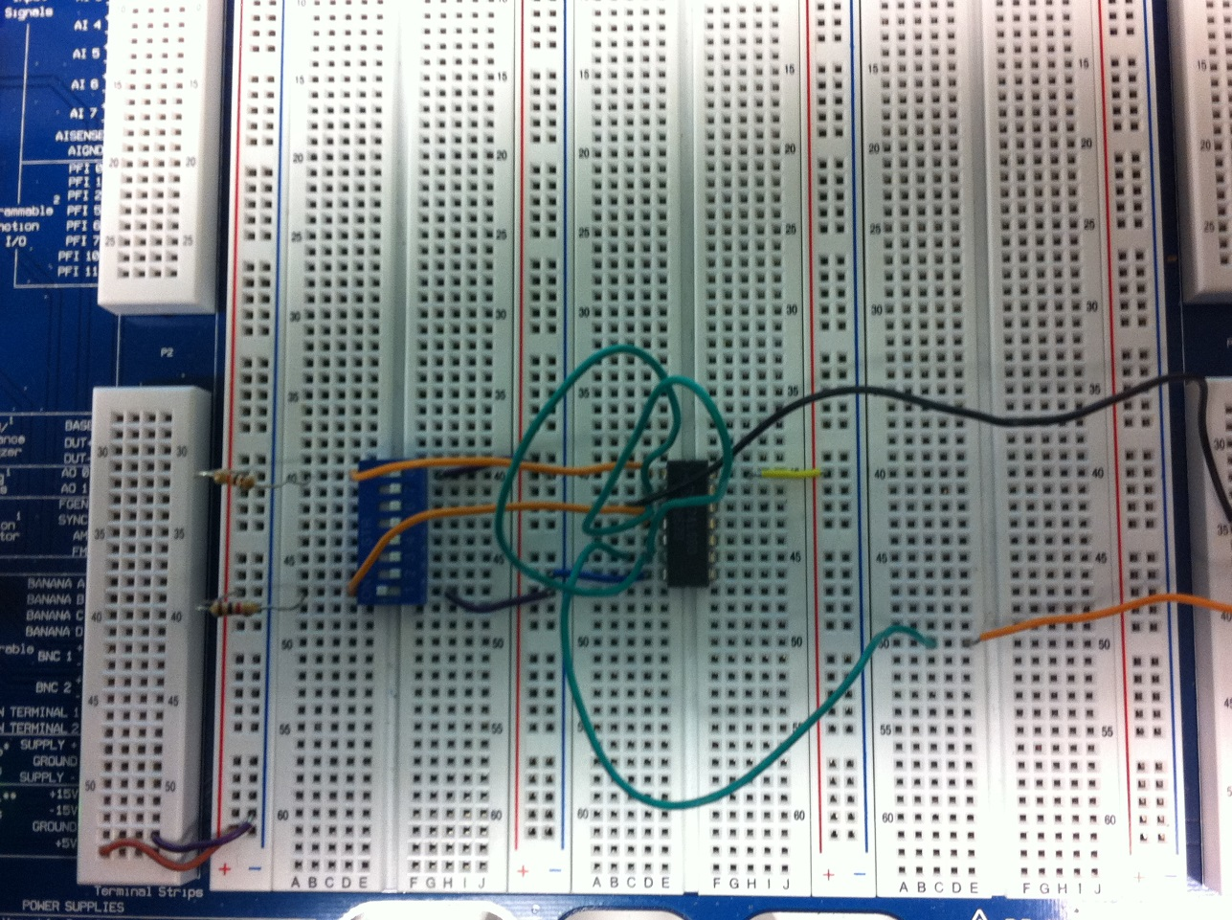
Data/Lab Results/Simulations/Schematics:

Slide 16
Troubleshooting and Conclusion:
The NAND latch circuits that were built in the lab correlated to the Multisim simulations and truth tables.

Slide 17
Lab 3
SR Latch
By: Cody Fletcher, Ramon Jamili
Bench 1
Instructor: Andy Bell
Class: EECT122

Slide 18
Objectives, Equipment, and Parts:
Simulate a Set/Reset Circuit in Multisim using 74LS279 chip
Muiltisim
74LS279 Data Sheet

Slide 19
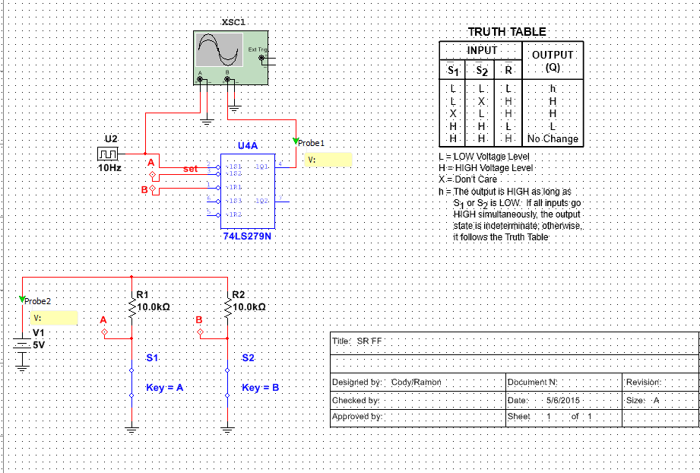
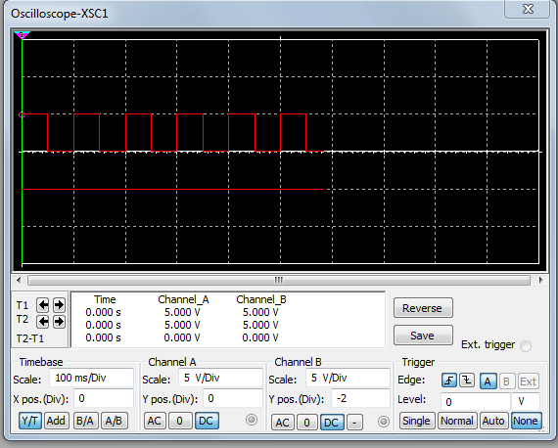
Data/Lab Results/Simulations/Schematics:

Slide 20
Troubleshooting and Conclusion:
Successfully simulated the set/reset circuit in Multisim using the 74LS279 chip.

Slide 21
Lab 4
D Latch
By: Cody Fletcher, Ramon Jamili
Bench 1
Instructor: Andy Bell
Class: EECT122

Slide 22
Objectives, Equipment, and Parts:
Simulate and create a D Latch in Multisim and in the Lab.
Elvis II S#1677D1E
(1) 74LS74 DUAL D-TYPE FLIP-FLOPS WITH PRESET AND CLEAR
(3) 1K OHM RESISTORS
(1) MULTI SWITCH
VARIOUS WIRE CONNECTORS
MULTI-CHANNEL OSCILLOSCOPE
CLOCK INPUT GENERATOR

Slide 23
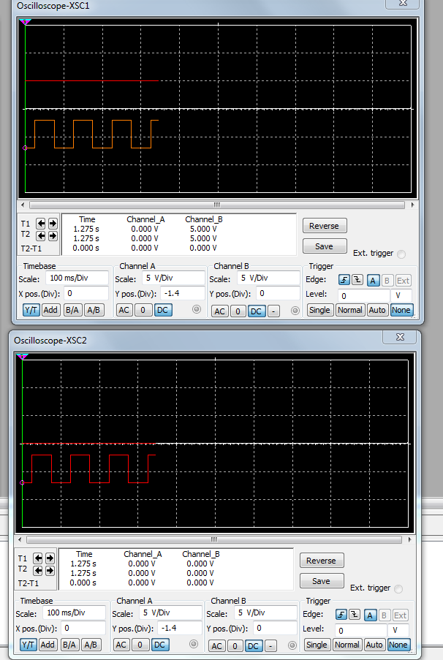
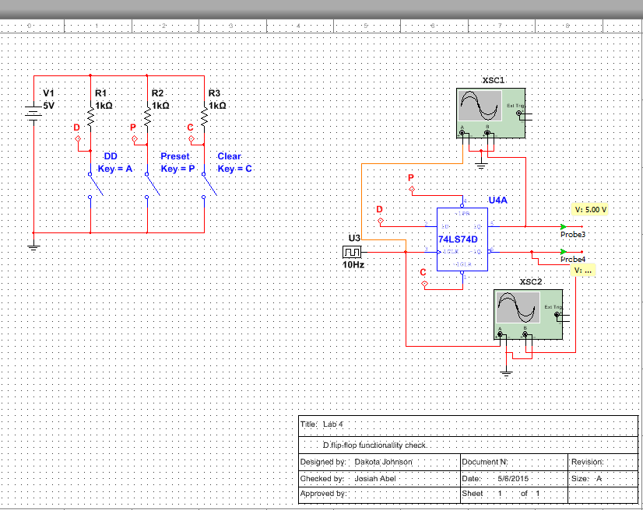
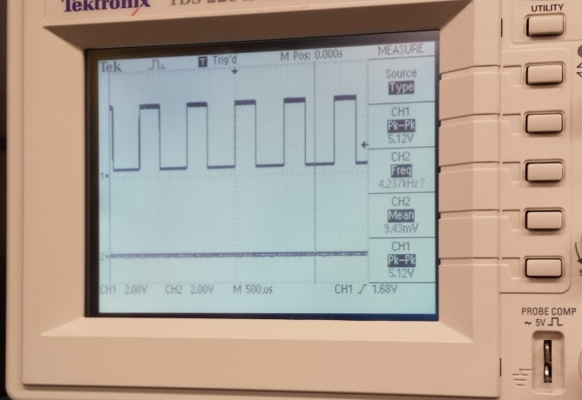
Data/Lab Results/Simulations/Schematics:

Slide 24
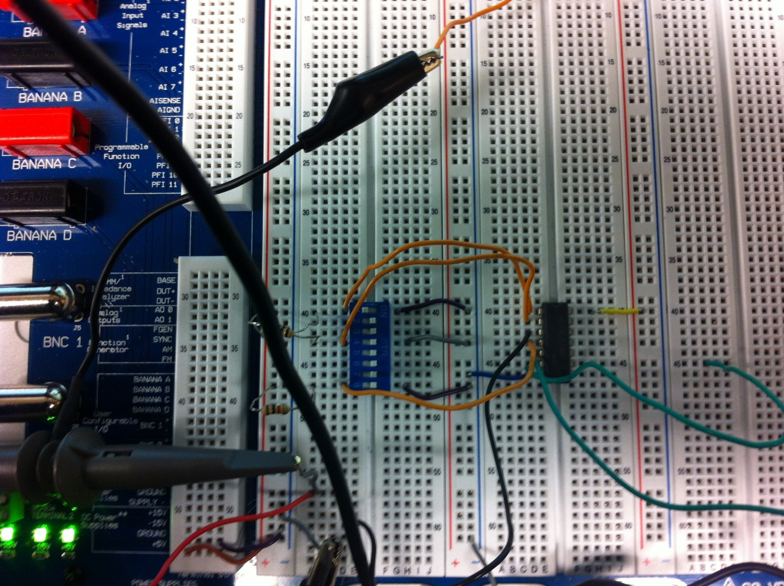
Data/Lab Results/Simulations/Schematics:

Slide 25
Troubleshooting and Conclusion:
THE CLOCKED D FLIP FLOP FUNCTIONED ACCORDING TO THE SIMULATION AND TO THE TRUTH TABLE. THE ONLY UNDISIRED CONDITION THAT WAS INCONCLUSIVE WAS WHEN CLEAR AND PRESET WERE BOTH IN A ACTIVE-LOW STATE.

Slide 26
Lab 5
JK Latch
By: Cody Fletcher, Ramon Jamili
Bench 1
Instructor: Andy Bell
Class: EECT122

Slide 27
Objectives, Equipment, and Parts:
Simulate and create a JK Flip Flop in Multisim and in the Lab.
Elvis II S#1677D1E
(1) 74LS73 CLOCKED JK FLIP-FLOP.
(1) MULTI SWITCH.
(2) 1K OHM RESISTORS.
VARIOUS WIRE CONNECTORS.
CLOCK INPUT GENERATOR.
MULTI CHANNEL OSCILLOSCOPE.

Slide 28
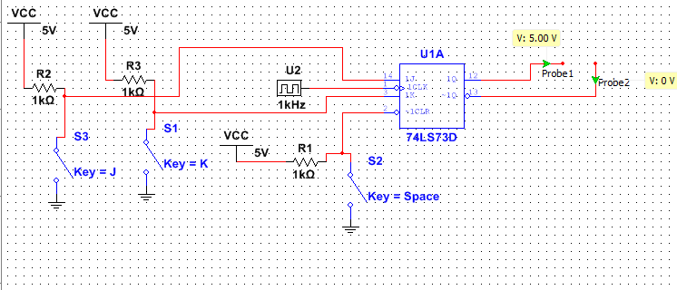
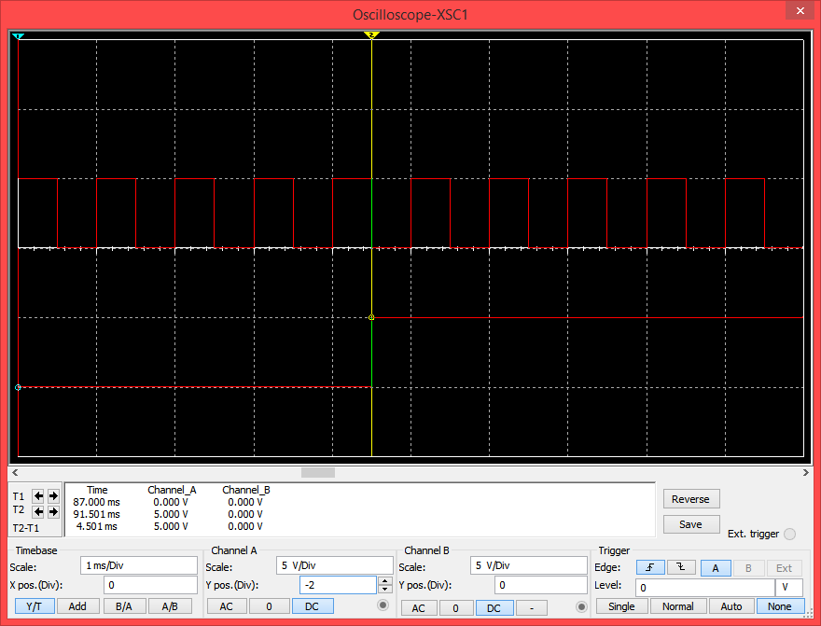
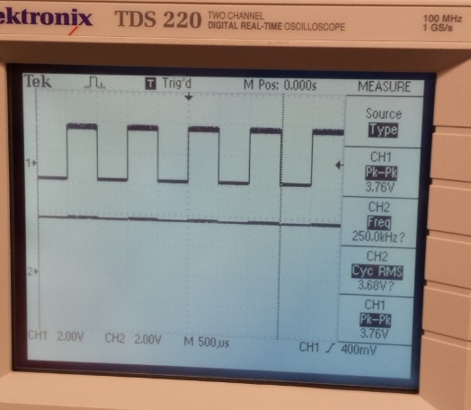
Data/Lab Results/Simulations/Schematics:

Slide 29
Troubleshooting and Conclusion:
THE JK CLOCKED FLIP FLOP OPERATED AT WE HAD EXPECTED IT TOO. THE TOGGLE MODE WORKED CORRECTLY AND BOTH THE INPUTS J AND K GAVE US THE DESIRED OUTPUTS THAT WE WERE LOOKING FOR. ONLY ISSUE WAS WITH THE ONE PICTURE OF THE OSCILLOSCOPE OTHER THAN THAT IT WAS A SUCCESSFUL SIMULATION AND TEST OF THE 74LS73 CHIP.

Slide 30
Lab 6
Adding Binary Numbers
By: Cody Fletcher, Ramon Jamili
Instructor: Andy Bell
Bench 1
Class: EECT122
Date: 2/18/15

Slide 31
Objectives, Equipment, and Parts:
Build a multisim simulation that adds two four bit numbers
Multisim
Excel

Slide 32
Data/Lab Results/Simulations/Schematics:
 | 0 | 0000 |  |  | 1 | 0001 |  |  | 1 | 0001 |  |  | 2 | 0010
 | 0 | 0000 |  |  | 0 | 0000 |  |  | 1 | 0001 |  |  | 1 | 0001
 | 0 | 0000 |  |  | 1 | 0001 |  |  | 2 | 0010 |  |  | 3 | 0011
 | 2 | 0010 |  |  | 3 | 0011 |  |  | 3 | 0011 |  |  | 4 | 0100
 | 2 | 0010 |  |  | 2 | 0010 |  |  | 3 | 0011 |  |  | 3 | 0011
 | 4 | 0100 |  |  | 5 | 0101 |  |  | 6 | 0110 |  |  | 7 | 0111
 | 5 | 0101 |  |  | 6 | 0110 |  |  | 5 | 0101 |  |  | 6 | 0110
 | 3 | 0011 |  |  | 3 | 0011 |  |  | 5 | 0101 |  |  | 5 | 0101
 | 8 | 1000 |  |  | 9 | 1001 |  |  | 10 | 1010 |  |  | 11 | 1011
 | 9 | 1001 |  |  | 8 | 1000 |  |  | 7 | 0111 |  |  | 10 | 1010
 | 3 | 0011 |  |  | 5 | 0101 |  |  | 7 | 0111 |  |  | 5 | 0101
 | 12 | 1100 |  |  | 13 | 1101 |  |  | 14 | 1110 |  |  | 15 | 1111

Slide 33
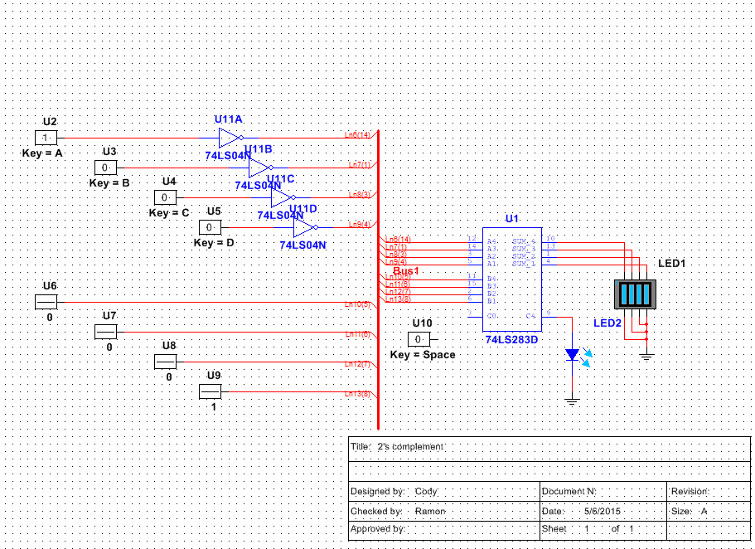
Data/Lab Results/Simulations/Schematics:

Slide 34
Troubleshooting and Conclusion:
Successfully simulated a 2’s compliment circuit in Multisim.

Slide 35
Lab 7
74lLS283
By: Cody Fletcher, Ramon Jamili
Bench 1
Instructor: Andy Bell
Class: EECT122

Slide 36
Objectives, Equipment, and Parts:
Simulate a 4 Bit Adder in Multisim.
Multisim

Slide 37
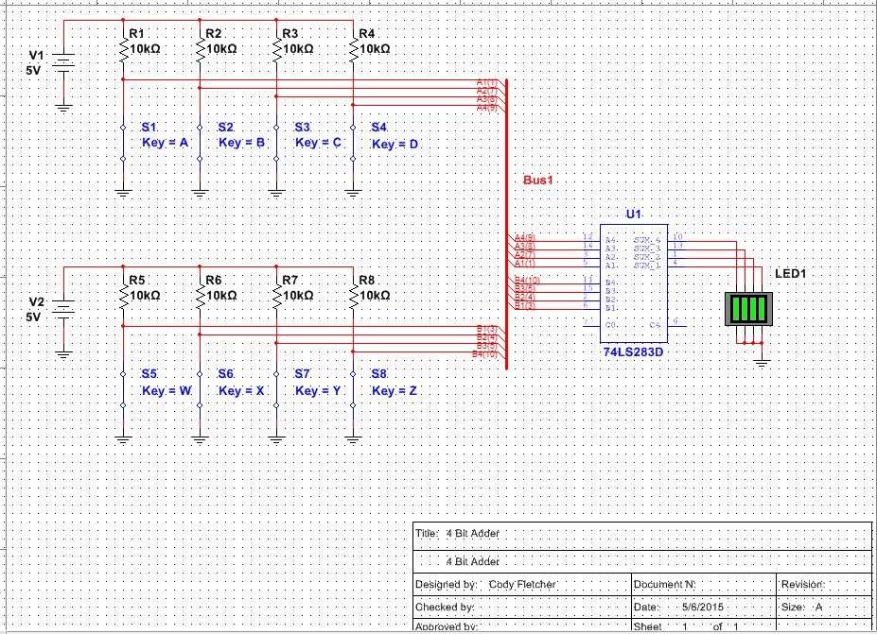
Data/Lab Results/Simulations/Schematics:

Slide 38
Troubleshooting and Conclusion:
Successfully simulated a 4 Bit Adder in Multisim

Slide 39
Lab 8
Asynchronous Counter
By: Cody Fletcher, Ramon Jamili
Bench 1
Instructor: Andy Bell
Class: EECT122

Slide 40
Objectives, Equipment, and Parts:
Simulate an Asynchronous Counter in Multisim.
Multisim

Slide 41
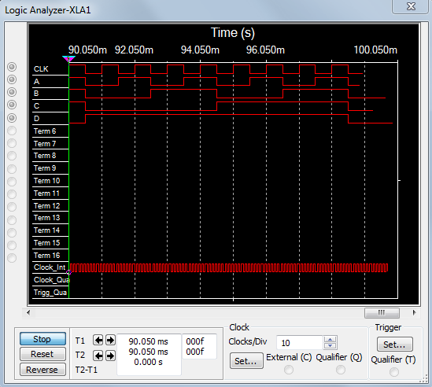
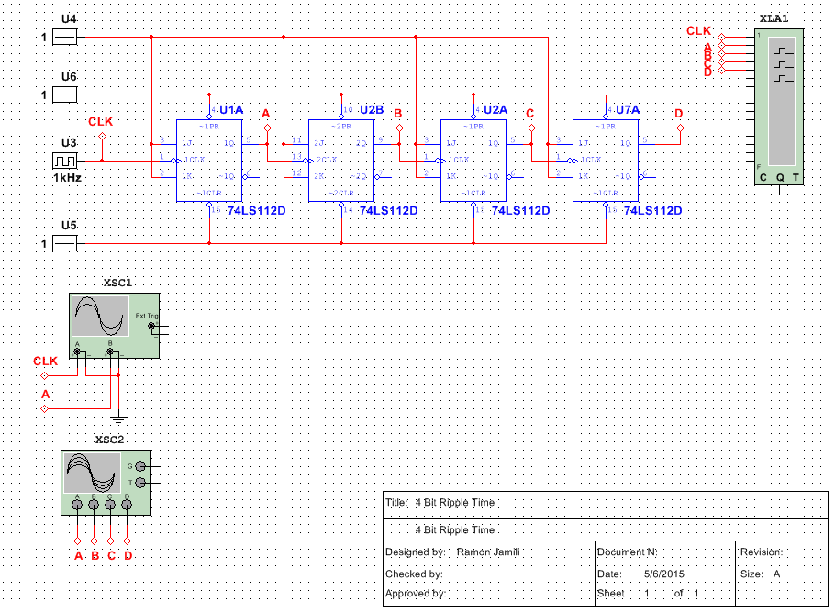
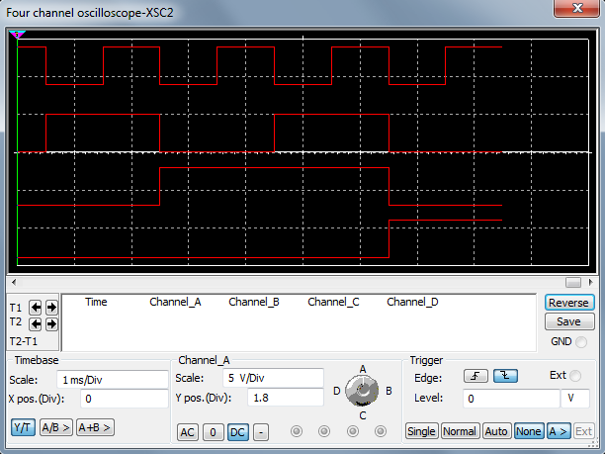
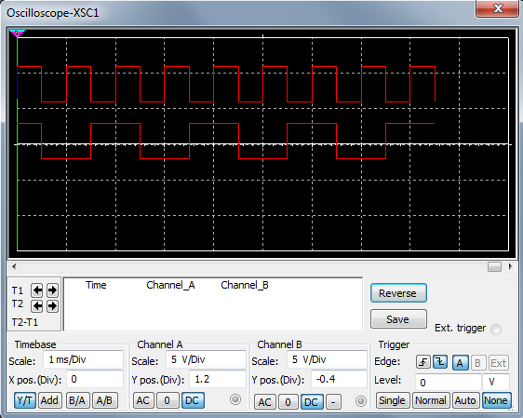
Data/Lab Results/Simulations/Schematics:

Slide 42
Troubleshooting and Conclusion:
Successfully simulated an Asynchronous Counter in Multisim.

Slide 43
Lab 9
Synchronous Counter
By: Cody Fletcher, Ramon Jamili
Bench 1
Instructor: Andy Bell
Class: EECT122

Slide 44
Objectives, Equipment, and Parts:
Simulate an Synchronous Counter in Multisim.
Multisim

Slide 45
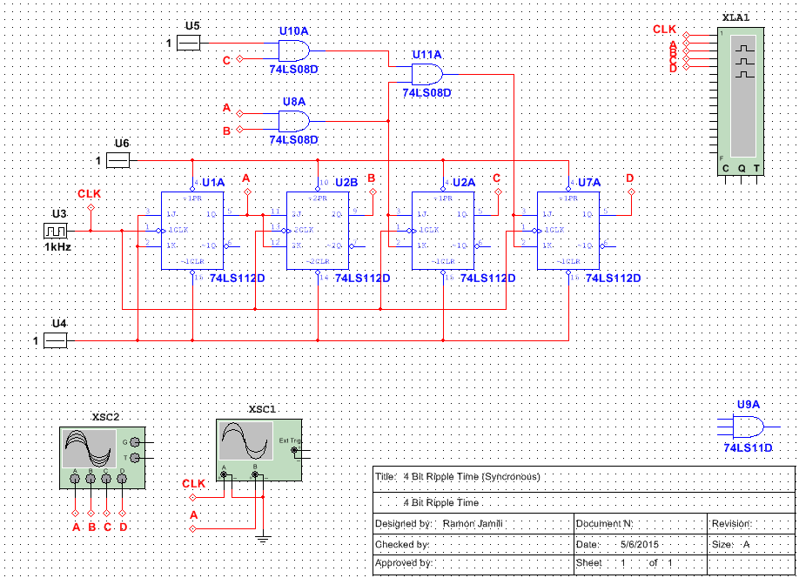

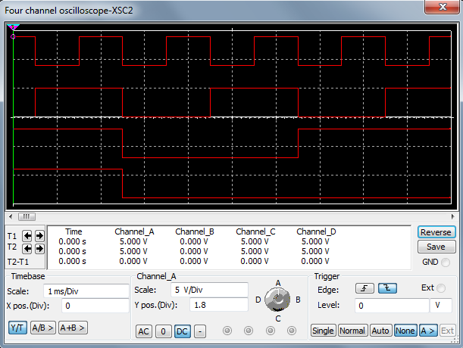
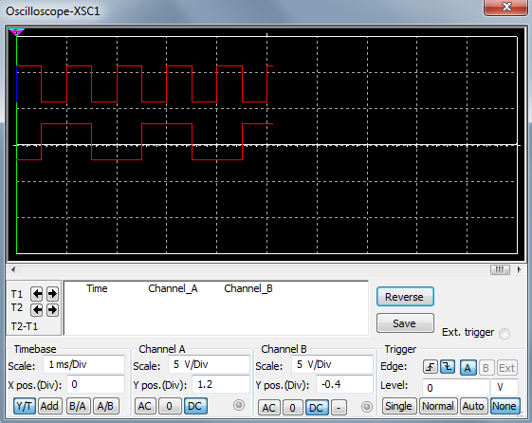
Data/Lab Results/Simulations/Schematics:

Slide 46
Troubleshooting and Conclusion:
Successfully simulated an Synchronous Circuit in Multisim.

Slide 47
Lab 10
MOD 12
By: Cody Fletcher, Ramon Jamili
Bench 1
Instructor: Andy Bell
Class: EECT122

Slide 48
Objectives, Equipment, and Parts:
Simulate and create in the Lab at MOD-12 Counter.
Multisim
Elvis II S#1677D1E
Multimeter
74LS112 Chips
74LS112 Data Sheet
74LS11 Chip
74LS11 Data Sheet
74LS00 Chip
74LS00 Data Sheet
LED
Various Wires

Slide 49
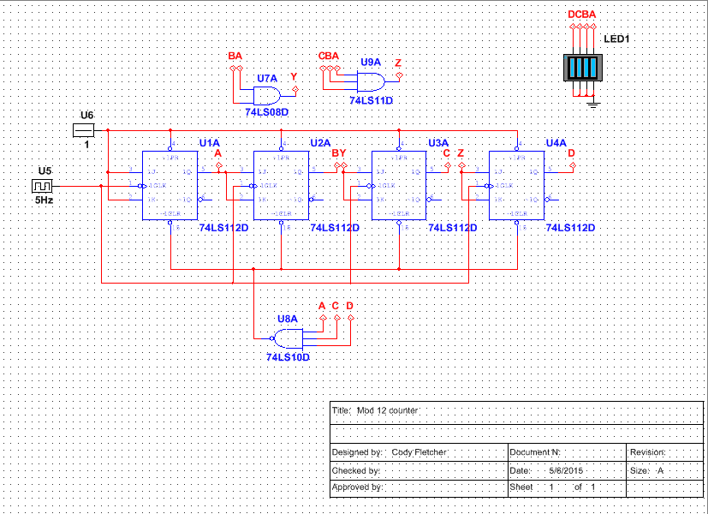
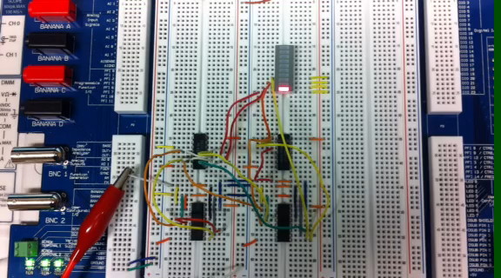
Data/Lab Results/Simulations/Schematics:

Slide 50
Troubleshooting and Conclusion:
Unable to successfully build the circuit in the Lab. Our Multisim simulation drew to much power on the Elvis II board and would not work.

Slide 51
Lab 11
CMOS Characterization
By: Cody Fletcher, Ramon Jamili
Bench 1
Instructor: Andy Bell
Class: EECT122

Slide 52
Objectives, Equipment, and Parts:
Calculate the Propagation delay in Multisim and in the Lab.
Compare Lab results with Data Sheets
Multisim
Elvis II S#1677D1E
74LS00 Chip
74LS00 Data Sheet
CD4011 Chip
CD4011 Data Sheet
Multimeter
Various wires

Slide 53
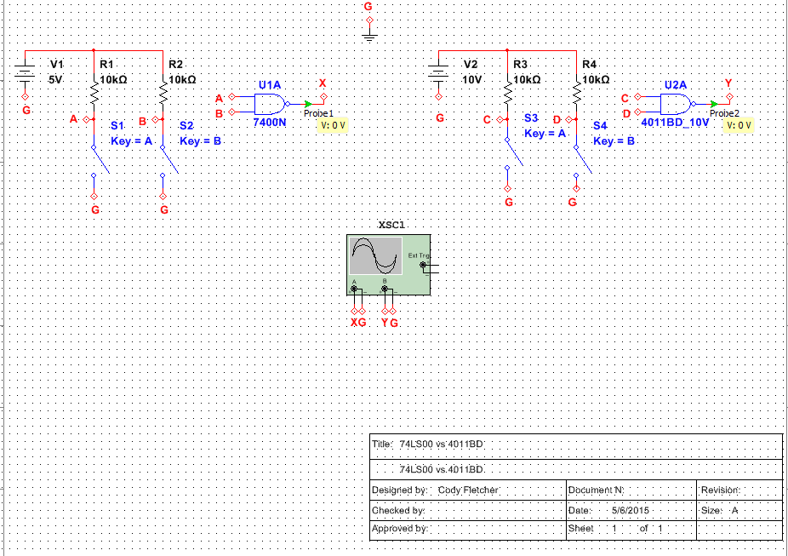
Data/Lab Results/Simulations/Schematics:

Slide 54
Troubleshooting and Conclusion:
Successfully calculated the propagation delay between the 2 chips.
Compared lab results with data sheets.

Slide 55
Lab 12
74LS138
By: Cody Fletcher, Ramon Jamili
Bench 1
Instructor: Andy Bell
Class: EECT122

Slide 56
Objectives, Equipment, and Parts:
Simulate and create a 74LS138 Decoder circuit in Multisim and in the lab.
Multisim
Elvis II S#1677D1E
74LS138 Chip
74LS138 Data Sheet
LED
Various Wires

Slide 57
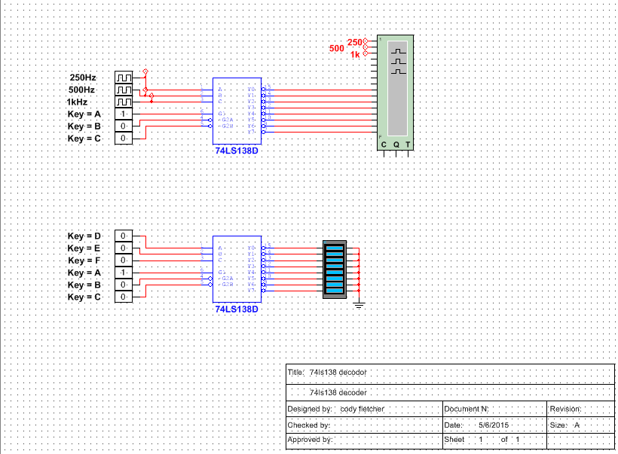
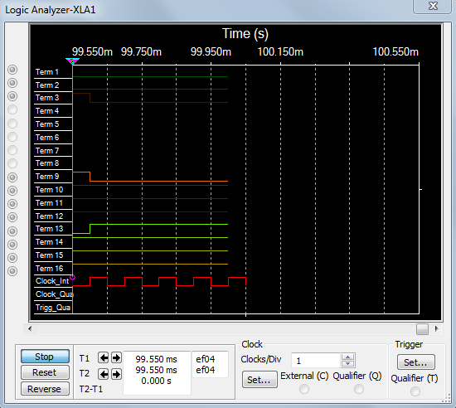
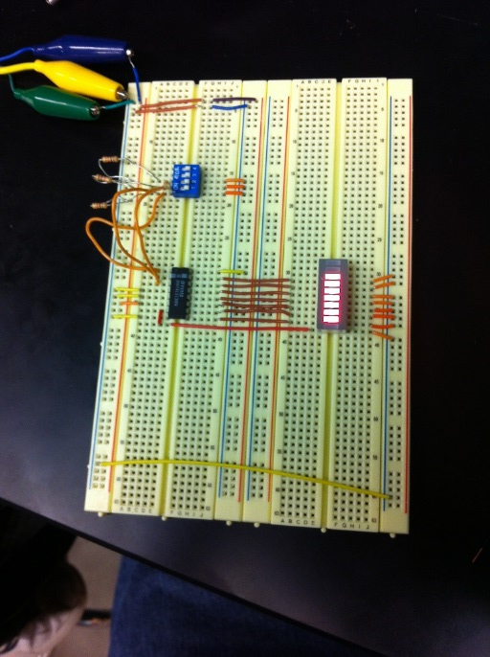
Data/Lab Results/Simulations/Schematics:

Slide 58
Troubleshooting and Conclusion:
Successfully simulated and created a 74LS138 Decoder in Multisim and in the Lab.

Slide 59
Lab 13
555 Timer 74LS90 74LS47 Hex display
By: Cody Fletcher, Ramon Jamili
Bench 1
Instructor: Andy Bell
Class: EECT122

Slide 60
Objectives, Equipment, and Parts:
Simulate and design a 555 Timer Hex Display in Multisim and in the Lab.
Multisim
Breadboard
555 Chip
555 Data Sheet
74LS90 Chip
74LS90 Data Sheet
74LS47 Chip
74LS47 Data Sheet
7 Segment Display
Various Risistors, Capacitor
Various Wires

Slide 61
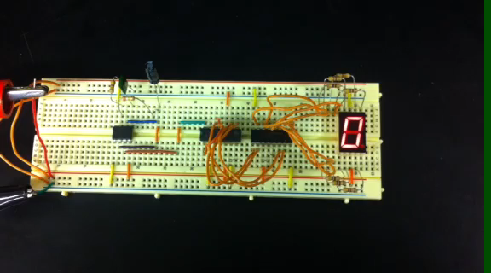
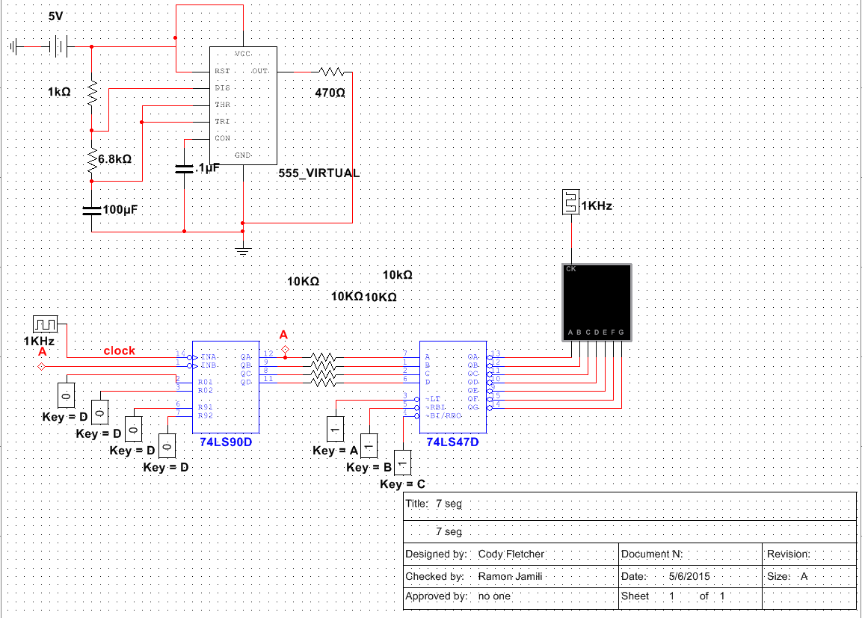
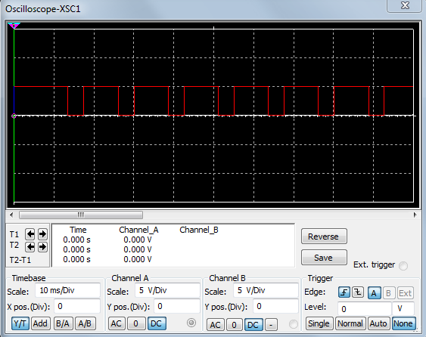
Data/Lab Results/Simulations/Schematics:

Slide 62
Troubleshooting and Conclusion:
Successfully simulated and designed a 555 Timer Hex Display.

Slide 63
Design 1
Make 3 clocks from 1
By: Cody Fletcher, Ramon Jamili
Bench 1
Instructor: Andy Bell
Class: EECT122

Slide 64
Objectives, Equipment, and Parts:
Create a way to turn One Clock into Three Clocks.
Multisim

Slide 65
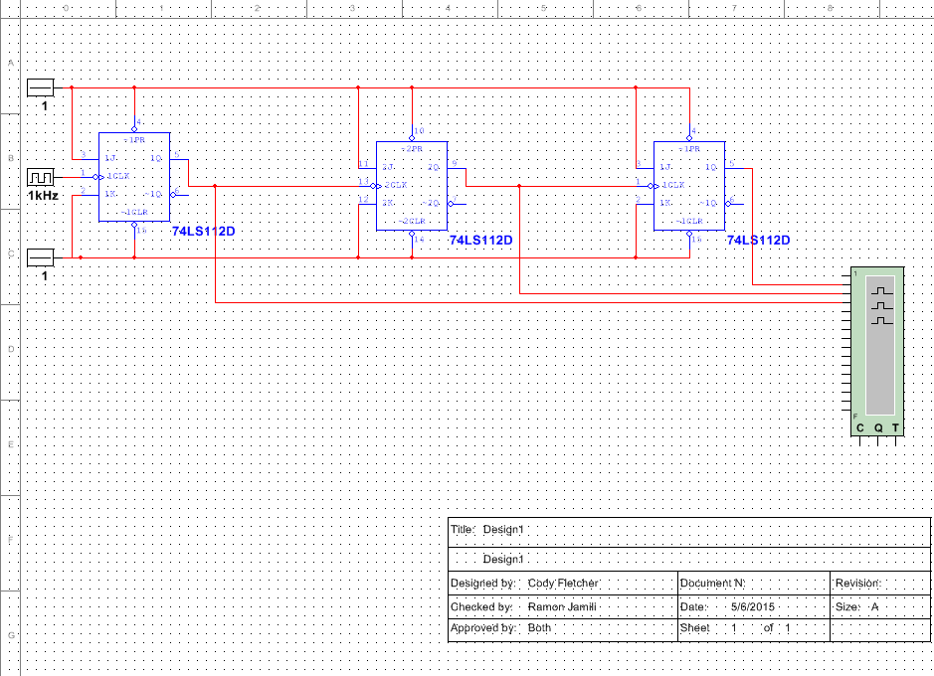
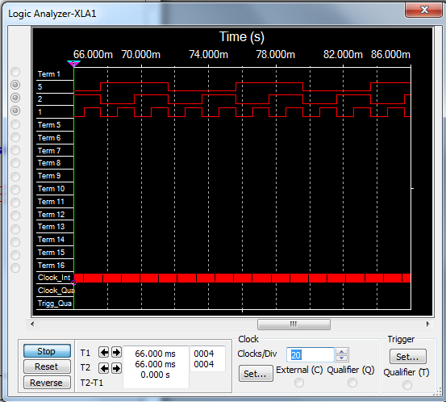
Data/Lab Results/Simulations/Schematics:

Slide 66
Troubleshooting and Conclusion:
Successfully simulated turning one clock into three.

Slide 67
Lab FF
Lou’s Design
By: Cody Fletcher, Ramon Jamili
Bench 1
Instructor: Andy Bell
Class: EECT122

Slide 68
Unable to perform this lab due to lack of time with Lou’s Design.

Slide 69
Data Sheets:
Click For
Data Sheets

